Slide 1



Sambe Consulting
Rushil Jivan
October 2026
Architecting Platforms.
Delivering Trusted Insight.
Enabling Intelligence.
Decision Intelligence, Reporting & Data Platforms
1

Slide 2


Contents
1
Project Outline
4
2
Loyalty Rewards
6
Pre-Owned Bikes
3
7
4
PayFast Integration
8
5
Resend Integration
9
DECISION INTELLIGENCE, REPORTING & DATA PLATFORMS

Slide 3

Introduction
Decision Intelligence, Reporting & Data Platforms
3

Slide 4
Project Outline
Inspiration: Rooted in a lifelong passion for cycling and identified a market gap for a local bicycle platform in Durban.
Industry Focus: Specialized e-commerce platform for cycling gear, new bikes, and pre-owned consignment.
Name & Origin: Named Ville Cycles after the local Westville community.
Platform Scope: Fully responsive e-commerce web application for new and pre-owned cycling gear.
Core Systems: Secure user authentication, mobile-first design, Inventory Management and PayFast checkout integration.

Slide 5
Features
Decision Intelligence, Reporting & Data Platforms
5

Slide 6

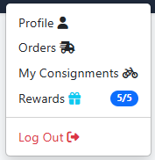
Loyalty Rewards
Designed to boost customer retention by rewarding frequent buyers, the feature was implemented in the database and checkout logic to automatically apply a 15% subtotal discount when redeemed.

Slide 7
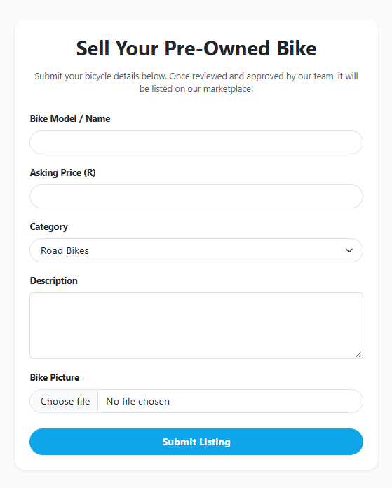
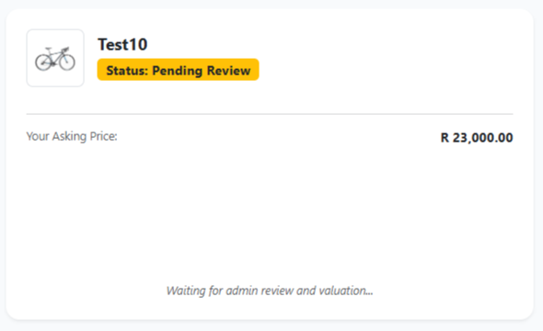
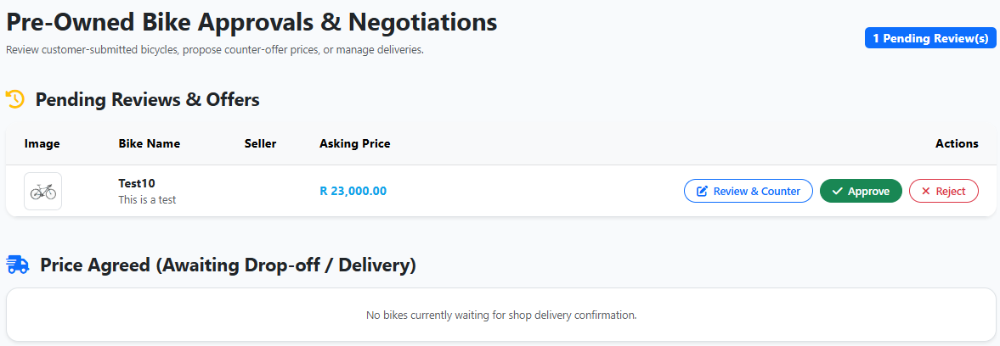
Pre-Owned Bikes
This feature was added and created to provide a trusted local marketplace for riders to sell their gear. The feature was implemented with a custom submission form, seller tracking, and admin approval workflows.

Slide 8

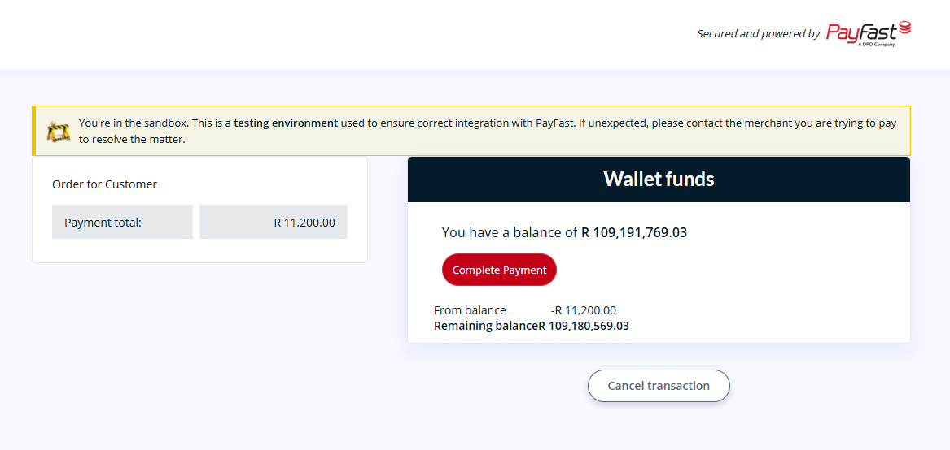
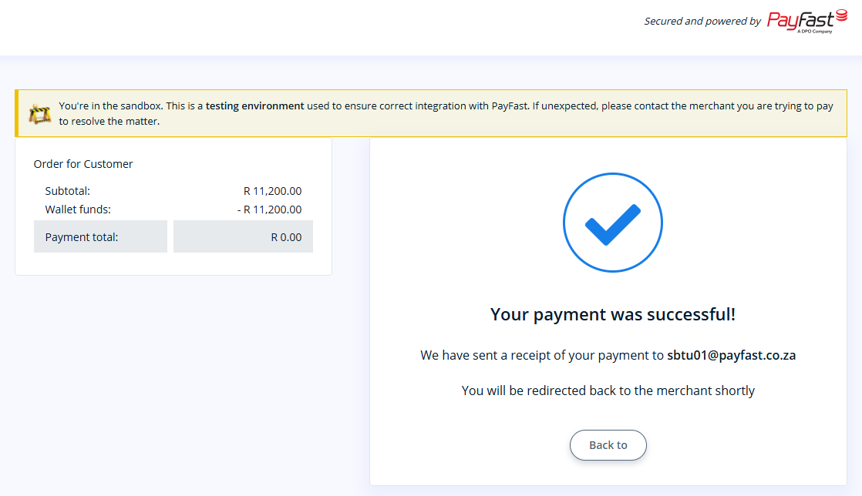
PayFast Integration
This feature was Implemented to handle secure transactions safely in South Africa, this feature uses the PayFast gateway API configured in a sandbox testing environment to process payments and trigger automated order invoices.

Slide 9
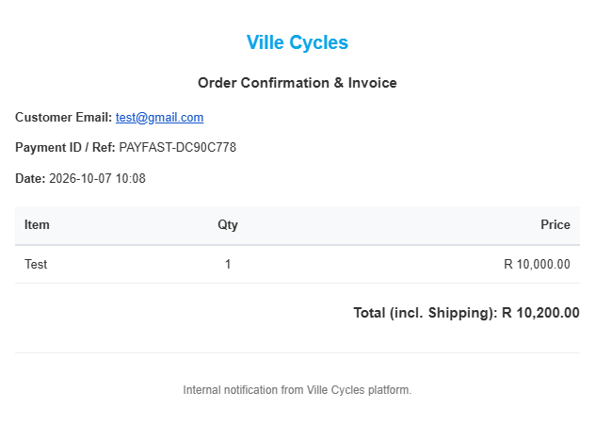
Resend Integration (Invoice via Email)
Implemented to handle backend transactional messaging, this feature uses the Resend API to automatically generate and email itemized HTML order invoices to customers upon successful checkout.

Slide 10
Thank You
Rushil Jivan
Decision Intelligence, Reporting & Data Platforms
10
10

